Slide 1
Software Failure
If there is any bug or any error in a program or a system then we will get incorrect or unpredicted result.
Due to error the behave of system will be inappropriate.

Slide 2
Program
Program can be defined as the set of instruction, that perform specific task.
Actually, program is developed by an individual or a group of programmers for their own use.
Further classification of a program is not possible.
There is no need to use SDLC(Software Development life cycle in program).
There is no need of well defined/dedicated user interface in program.

Slide 3
Software
Software is a collection of programs.
There may be bundles of programs and data files in software.
There is need to use SDLC(Software Development life cycle) in software.
There is a well defined/dedicated user interface in software.

Slide 4
SDLC
Software Development Life Cycle (SDLC) is a process used by the software industry to design, develop and test high quality softwares.
The SDLC aims to produce a high-quality software that meets or exceeds customer expectations, reaches completion within times and cost estimates.
It consists of a detailed plan describing how to develop, maintain, replace and alter or enhance specific software.

Slide 5
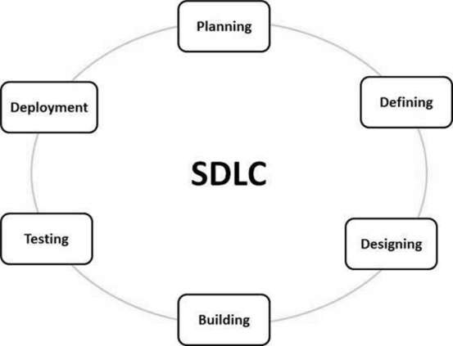
The following figure is a graphical representation of the various stages of a typical SDLC.

Slide 6
Stage 1: Planning and Requirement Analysis
It is performed by the senior members of the team with inputs from the customer, the sales department, market surveys and domain experts in the industry.
This information is then used to plan the basic project approach and to conduct product feasibility study in the economical, operational and technical areas.
Planning for the quality assurance requirements and identification of the risks associated with the project is also done in the planning stage.
The outcome of the technical feasibility study is to define the various technical approaches that can be followed to implement the project successfully with minimum risks.

Slide 7
Stage 2: Defining Requirements
Once the requirement analysis is done the next step is to clearly define and document the product requirements and get them approved from the customer or the market analysts.
This is done through an SRS (Software Requirement Specification) document which consists of all the product requirements to be designed and developed during the project life cycle.

Slide 8
Stage 3: Designing the Product Architecture
SRS is the reference for product architects to come out with the best architecture for the product to be developed.
Based on the requirements specified in SRS, usually more than one design approach for the product architecture is proposed and documented in a DDS - Design Document Specification.
This DDS is reviewed by all the important stakeholders and based on various parameters as risk assessment, product robustness, design modularity, budget and time constraints, the best design approach is selected for the product.

Slide 9
Stage 4: Building or Developing the Product
In this stage of SDLC the actual development starts and the product is built.
The programming code is generated as per DDS during this stage.
Developers must follow the coding guidelines defined by their organization and programming tools like compilers, interpreters, debuggers, etc. are used to generate the code.
Different high level programming languages such as C, C++, Pascal, Java and PHP are used for coding. The programming language is chosen with respect to the type of software being developed.

Slide 10
Stage 5: Testing the Product
This stage is usually a subset of all the stages as in the modern SDLC models, the testing activities are mostly involved in all the stages of SDLC.
However, this stage refers to the testing only stage of the product where product defects are reported, tracked, fixed and retested, until the product reaches the quality standards defined in the SRS.

Slide 11
Stage 6: Deployment in the Market and Maintenance
Once the product is tested and ready to be deployed it is released formally in the appropriate market.
Sometimes product deployment happens in stages as per the business strategy of that organization.
The product may first be released in a limited segment and tested in the real business environment (UAT- User acceptance testing).
Then based on the feedback, the product may be released as it is or with suggested enhancements in the targeting market segment.

